Slide 1





























INFORMATION SYSTEMS

Slide 2

What is Information Systems?
Pre-IS
Application
Junior Core
Post Core
Careers

Slide 3
You’ll learn how to put technology to work.
–The College Board,
Speaking about Information Systems

Slide 4
What is information systems
Management
Accounting
BUSINESS
Finance
Marketing
Operations
Pre-IS
Application
Junior Core
Post Core
Careers

Slide 5
What is information systems
Management
Accounting
BUSINESS
Finance
Marketing
Operations
Pre-IS
Application
Junior Core
Post Core
Careers

Slide 6

What is information systems
Hardware
Software
BUSINESS
Development
TECHNOLOGY
Analytics
Cyber Security
Pre-IS
Application
Junior Core
Post Core
Careers

Slide 7
What is information systems
Hardware
Software
BUSINESS
Development
TECHNOLOGY
Analytics
Cyber Security
Pre-IS
Application
Junior Core
Post Core
Careers

Slide 8
What is information systems
BUSINESS
TECHNOLOGY
Pre-IS
Application
Junior Core
Post Core
Careers

Slide 9
What is information systems
INFORMATION
SYSTEMS
BUSINESS
TECHNOLOGY
Pre-IS
Application
Junior Core
Post Core
Careers

Slide 10
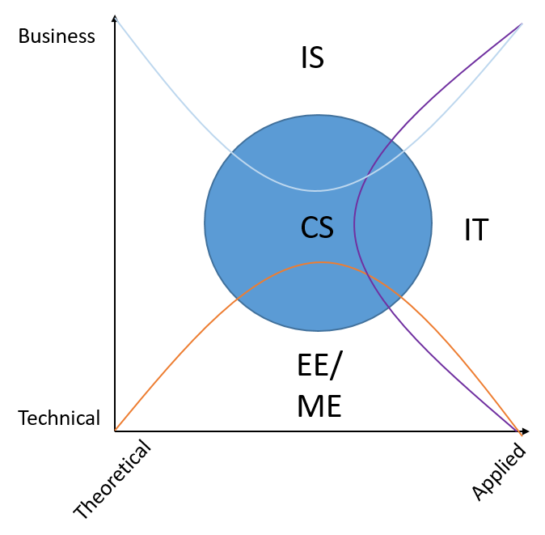

Pre-IS
Application
Junior Core
Post Core
Careers

Slide 11
Pre-IS
Pre-IS
Application
Junior Core
Post Core
Careers

Slide 12
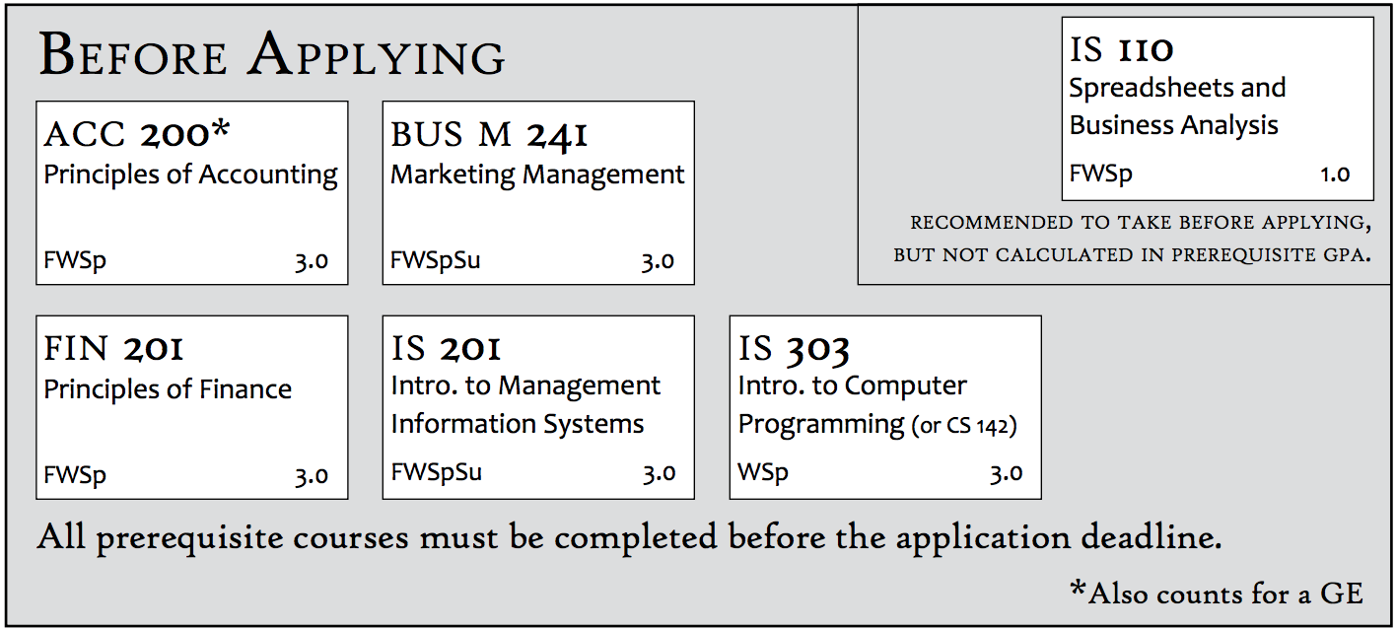


Pre-IS
Application
Junior Core
Post Core
Careers

Slide 13
Pre-IS
Application
Junior Core
Post Core
Careers

Slide 14
Pre-IS
Application
Junior Core
Post Core
Careers

Slide 15
Build Your Resume
Pre-IS
Application
Junior Core
Post Core
Careers

Slide 16
When are you ready?
Engage in Projects
Majority of Generals finished
Completed Pre-reqs
and if possible - Mcom 320, Stat 121, & Econ 110
Learn New Technologies
Pre-IS
Application
Junior Core
Post Core
Careers

Slide 17
Build Your Resume
Engage in Projects
Learn New Technologies
Pre-IS
Application
Junior Core
Post Core
Careers

Slide 18
Build Your Resume
Engage in Projects
Learn New Technologies
Learn New Technologies
Pre-IS
Application
Junior Core
Post Core
Careers

Slide 19
Build Your Resume
Engage in Projects
Learn New Technologies
Pre-IS
Application
Junior Core
Post Core
Careers

Slide 20

Learn new skills
Figure out if IS is for you
WHERE: IS lab (w328)
WHEN: 2nd and 4th Thursday of the month
@ 7:30pm
Pre-IS
Application
Junior Core
Post Core
Careers

Slide 21
The Application
Pre-IS
Application
Junior Core
Post Core
Careers

Slide 22


June 29th
4:30pm
Pre-IS
Application
Junior Core
Post Core
Careers

Slide 23
The Application
Pre-IS
Application
Junior Core
Post Core
Careers

Slide 24
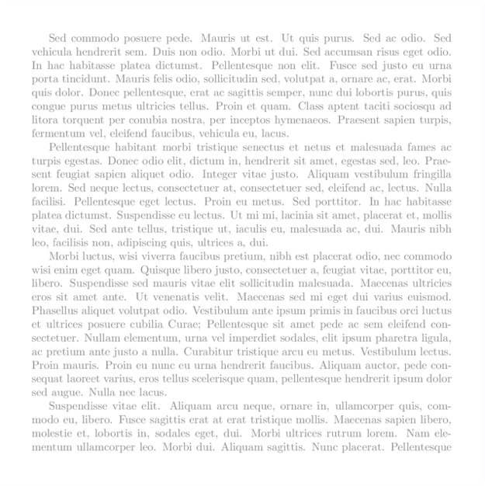
The Application
RESUME
A Short Essay
Pre-IS
Application
Junior Core
Post Core
Careers

Slide 25
The Application
Resume Help
http://bit.ly/2yKOAcV
Pre-IS
Application
Junior Core
Post Core
Careers

Slide 26
Minimum Requirements
3.0 Average in Prereq Classes
Grade of B or better in IS 201 and IS 303
No more than 1 repeat per course
Pre-IS
Application
Junior Core
Post Core
Careers

Slide 27
Minimum Requirements
Repeated and transfer courses will be discounted .33 of a grade during the admissions process - for example, from an ‘A’ to an ‘A-“
Pre-IS
Application
Junior Core
Post Core
Careers

Slide 28
Minimum Requirements
No more than 15 - 18 credits of generals.
If you do, then you can defer or need a plan
Pre-IS
Application
Junior Core
Post Core
Careers

Slide 29
Minimum Requirements
Meeting or exceeding admission criteria
does not guarantee admission.
Pre-IS
Application
Junior Core
Post Core
Careers

Slide 30
The Admissions Committee
Describe technical background / experience, illustrate strengths,
explain transcript discrepancies,
and create a memorable impression
1. Compelling Essay
2. Strong Academics
3. Build Relationships
4. Professionalism
Pre-IS
Application
Junior Core
Post Core
Careers

Slide 31
The Admissions Committee
3.5 GPA or above overall preferred
Consistent improvement over 2 semesters
1. Compelling Essay
2. Strong Academics
3. Build Relationships
4. Professionalism
Pre-IS
Application
Junior Core
Post Core
Careers

Slide 32
The Admissions Committee
Form relationships with the professors
1. Compelling Essay
2. Strong Academics
3. Build Relationships
4. Professionalism
Pre-IS
Application
Junior Core
Post Core
Careers

Slide 33
The Admissions Committee
Helping
Kind
Collaborative
1. Compelling Essay
2. Strong Academics
3. Build Relationships
4. Professionalism
Pre-IS
Application
Junior Core
Post Core
Careers

Slide 34
Stan Wilson
Pre-IS
Application
Junior Core
Post Core
Careers

Slide 35
Life in the Program
Pre-IS
Application
Junior Core
Post Core
Careers

Slide 36
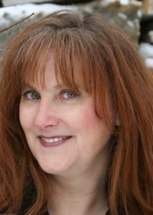
Caroline Thorne
Rhonda Sandberg
Pre-IS
Application
Junior Core
Post Core
Careers

Slide 37




Design
Network
Analyze
Code
Pre-IS
Application
Junior Core
Post Core
Careers

Slide 38
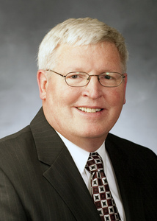
Reid Grawe
Pre-IS
Application
Junior Core
Post Core
Careers

Slide 39
Average Starting Salaries
Pre-IS
Application
Junior Core
Post Core
Careers

Slide 40

Kent Dodds
Web Developer
Pre-IS
Application
Junior Core
Post Core
Careers
Hilary Hayes
IT Advisory

Slide 41

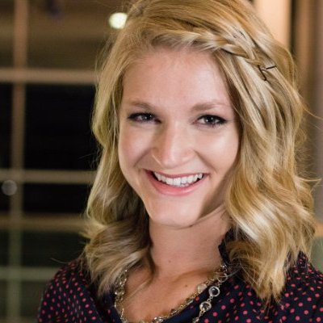
Kent Dodds
Web Developer
Cathy Kennelly
Risk Assurance
Pre-IS
Application
Junior Core
Post Core
Post Core
Careers
Julia Knecht
Cyber Security

Slide 42



Hilary Hayes
IT Advisory
Spencer Shumway
Program Manager
Pre-IS
Application
Junior Core
Post Core
Careers
Nick Walter
Mobile Developer

Slide 43

$66,000
Nick Walter
Mobile Developer
Pre-IS
Application
Junior Core
Post Core
Careers

Slide 44
$66,000
Nick Walter
Mobile Developer
Pre-IS
Application
Junior Core
Post Core
Careers
Breanna Bowden
User Experience Design

Slide 45

$66,000
Nick Walter
Mobile Developer
Breanna Bowden
User Experience Design
Pre-IS
Application
Junior Core
Post Core
Careers
Emily Cookson
Data Analytics

Slide 46


Breanna Bowden
User Experience Design
Becky Abbott
Data Analytics
Pre-IS
Application
Junior Core
Post Core
Careers
Steven Dewey
Consulting

Slide 47

Emily Cookson
Data Analytics
Trevor Harmon
Consulting
Pre-IS
Application
Junior Core
Post Core
Careers
Ben Turley
Entrepreneur at Innovation Labs
Kirk Ouimet
Project Manager at Snapchat

Slide 48


$54m
Ben Turley
Entrepreneur at Innovation Labs
Kirk Ouimet
Project Manager at Snapchat
Pre-IS
Application
Junior Core
Post Core
Careers

Slide 49
$54m
Ben Turley
Entrepreneur at Innovation Labs
Kirk Ouimet
Project Manager at Snapchat
Pre-IS
Application
Junior Core
Post Core
Careers

Slide 50

Women in Technology

Slide 51
CareerLaunch
https://careerlaunch.byu.edu/clubs/ais/
Join AIS
https://marriottschool.byu.edu/clubs/directory

